Slide 1
15.763 Administrative Issues
Friday April 29 is last scheduled recitation, due to May 6 conflict
  Review concepts from this week, answer anything about BigFig
FlexCap software (Class 09) has a registration process like OPT
The optimal solution to Seagate depends on how you define the objective function (i.e., the decision maker’s intent)
  In practice, you would ask
  Reinforces why scope, granularity, and intent produces a model with the narrowest scope, coarsest granularity, the achieves the decision maker’s intent
  Success benchmark: can we take decision maker’s data and give them a solution which they believe is better than the solution they would have created without our presence

Slide 2
Seagate Solution Approach
Seagate can be solved as a stochastic program with recourse
I did not teach this in advance for three reasons
  Solution can be enumerated (or extreme points can be identified like in Opt)
  Building intuition is important in advance of today’s discussion
  The result from the stochastic program is not super intuitive
Aside: enumeration is your friend, and a valuable tool in your kit
  What are the five best solutions?
  How many solutions are within 2% of the optimal value?
  What are the most different solutions within some tolerance?
  …these are all questions well suited to enumerative techniques

Slide 3
Stochastic Programming With Recourse
Stage 1 decision variables determined before uncertainty event
Stage 2 decision variables determined after uncertainty event is resolved (so there is no longer uncertainty)
  Stage 2 decision variables are constrained by Stage 1 decisions
  Stage 1 decisions are made taking into account Stage 2 reactions

Slide 5
Stochastic Programming Notation
Three sets
  Product family set – F ∈ {Barracuda, Cheetah}
  Resource set – R ∈ {Barracuda, Cheetah, Test}
  Demand scenario set – S ∈ {Pessimistic, Most Likely, Optimistic}
Decision variables
  Resource capacity levels – U_{i} ∀ i ∈ R
  Production quantity – Q_{ij} ∀ i ∈ F , j ∈ S
Parameters
  Capacity cost per unit – c_{i} ∀ i ∈ R
  Scenario probability – p_{j} ∀ j ∈ S
  Margin per unit – m_{i} ∀ i ∈ F
  Product demand – d_{ij} ∀ i ∈ F , ∀ j ∈ S

Slide 6
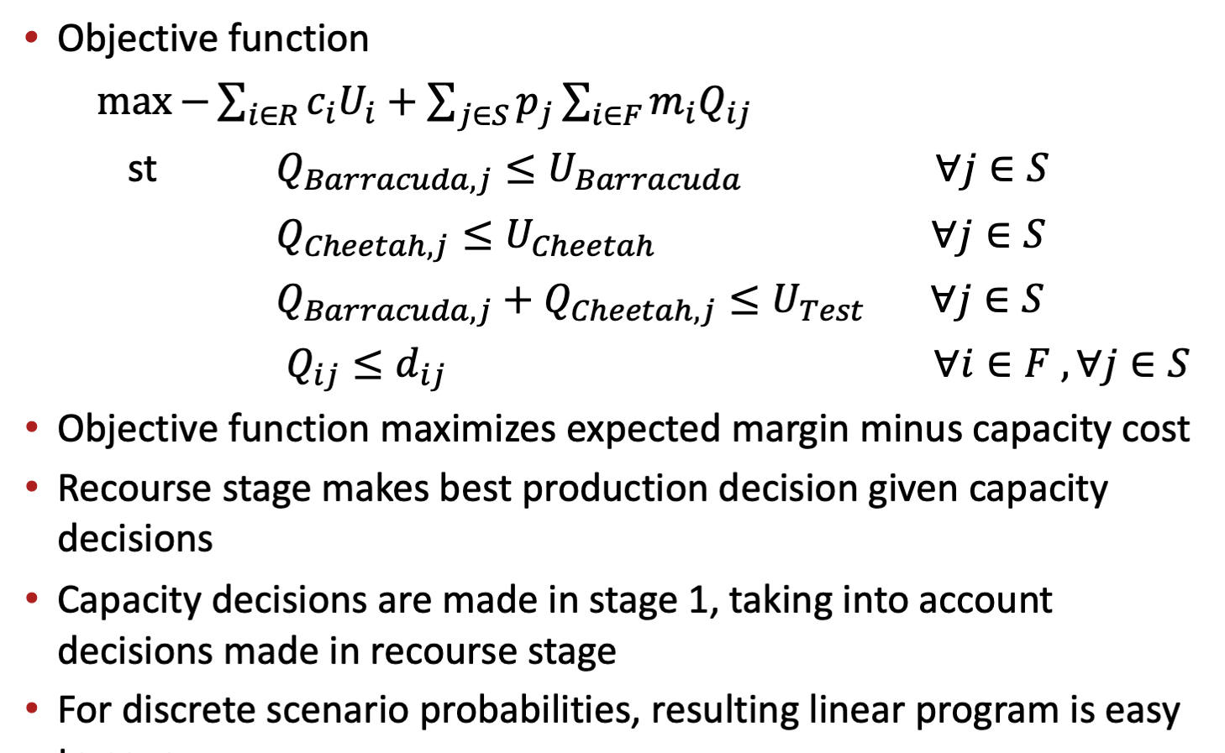
Stochastic Programming Formulation

Slide 7
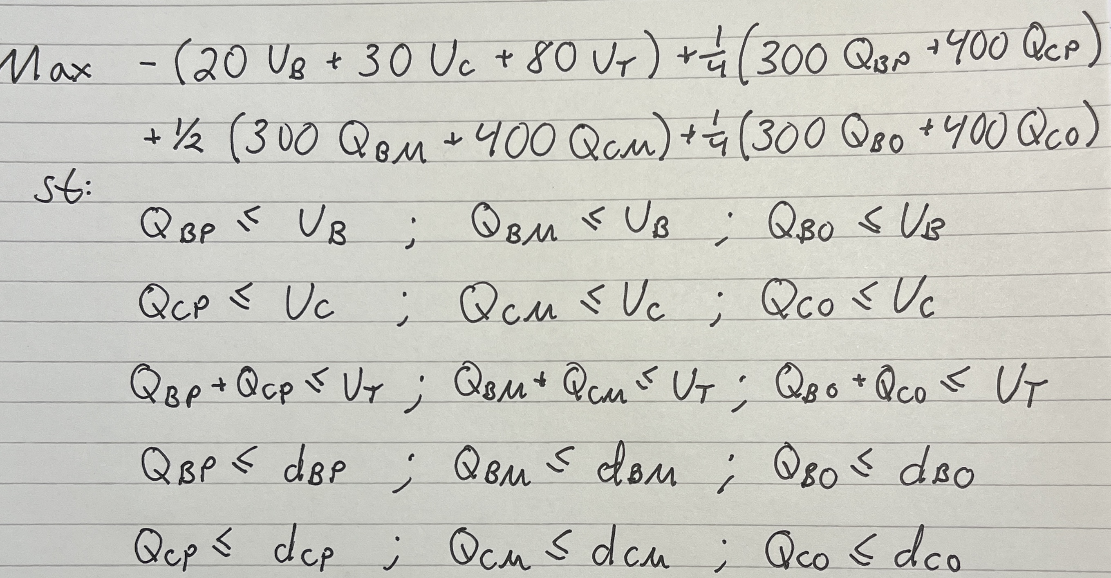
Handwritten Stochastic Program For Seagate

Slide 8

Please complete the end-of-class two-question survey
What is your main learning?
What is your unanswered question?
https://bit.ly/15763end

